Slide 1

Inclusion
SADC Mobile Money Guidelines and the key success factors to enhance the adoption

Slide 2

Overview of the revised SADC Mobile Money Guidelines
01
02
03
Key changes
Cross Border Harmonization and Alignment
Digitized and centralised KYC
Review of use cases beyond P2P
Revised SADC Mobile Money Guidelines 2024
Pillars of the revised SADC Mobile Money Guidelines
Enhancing the adoption of digital financial services using mobile money services.

Slide 3



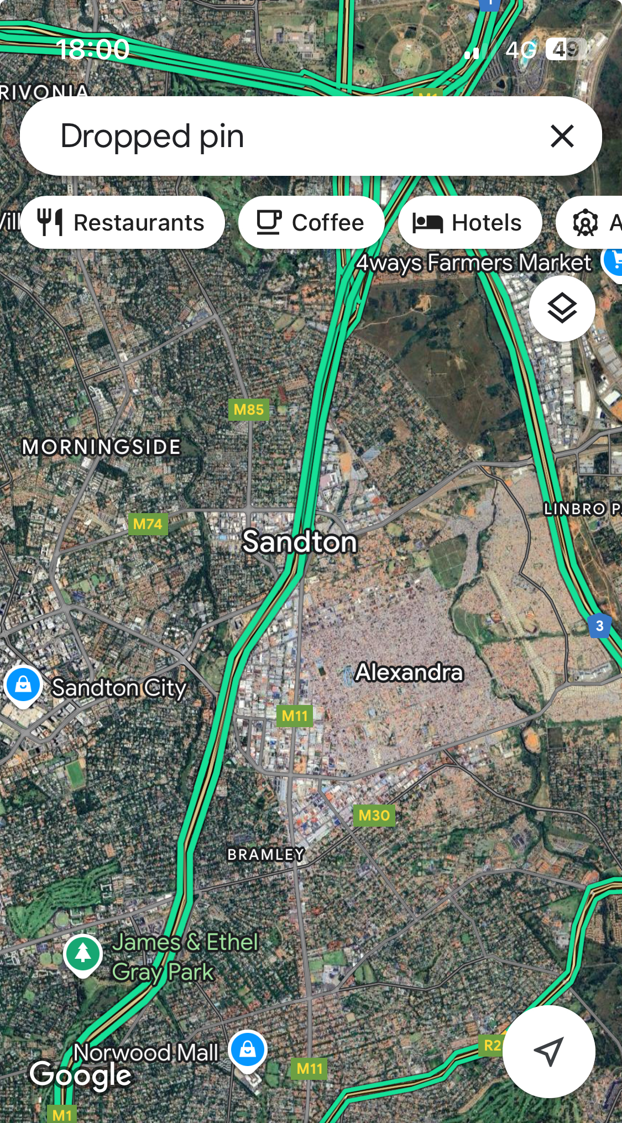
Inclusion measures
Photos by alamy.com

Slide 4

Pillars that guided revision of the Guidelines

Slide 5








International Guidelines underpinned the assessment
Frameworks used
Mobile Money Regulatory Index (MMRI)
Payments Aspects of Financial Inclusion (PAFI)
Financial Action Task Force (FATF) Supervision Models
Dimension 1
Dimension 2
Dimension 3
Dimension 4
Dimension 5
Dimension 6
Authorisation
Consumer Protection
Transaction Limits
KYC
Agent Networks
Investment & Infrastructure Environment

Slide 6
International Guidelines underpinned the assessment
PAFI
FATF
Public and Private Sector Commitment
Legal and Regulatory Framework
Financial and ICT infrastructure
Transaction account and payment product offering
Access Points
Awareness of financial literacy effort
Large volume and recurrent payment streams
AML/CFT Policies and Coordination
Money laundering and confiscation
Terrorist financing and financing of proliferation
Preventive measures
Transparency and beneficial ownership of legal persons and arrangements
International cooperation

Slide 7
The Mobile Money Stack

Slide 8
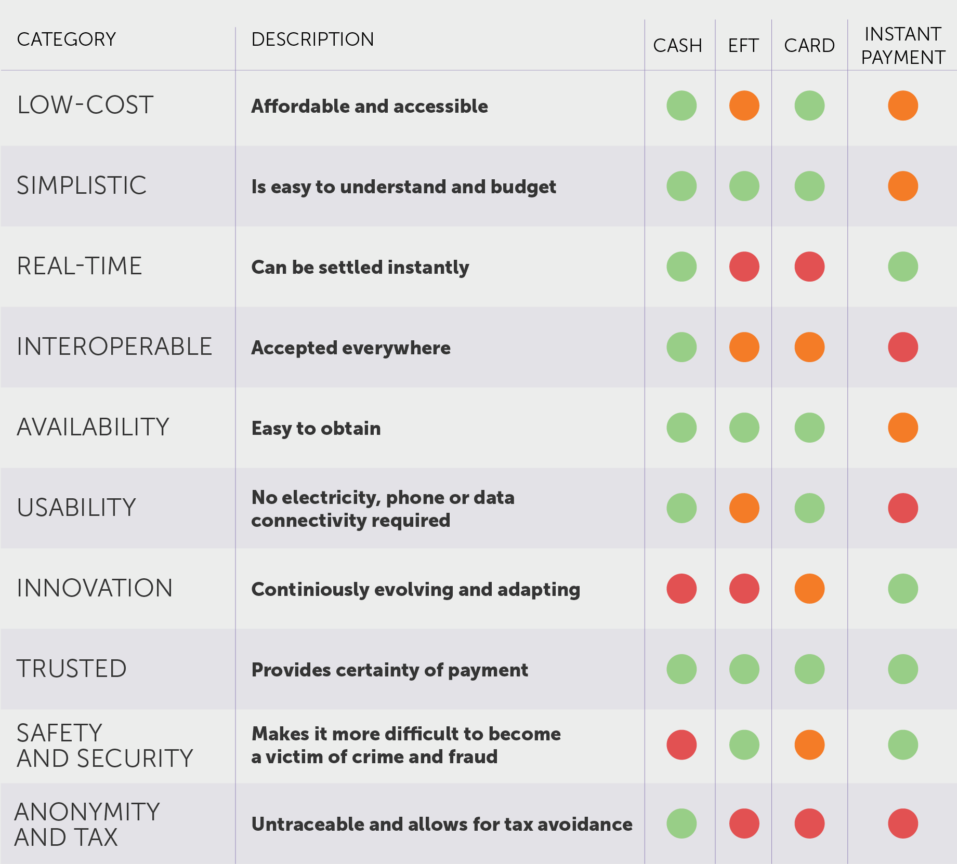
Money/Payments/RTS
Just like cash?
Viability
(Business)
No transaction fees?
Desirability
(Human)
Mobile money
No transaction levies?
Feasibility
(Technical)
New business models?
Regional integration?
Credit: entelect

Slide 9
Mobile Money
“Along the value chain, mobile money, as a form of e-money, essentially facilitates the storage, payment, and digital transfer of funds as a stored value facility once e-money has been issued against a trust account.”
Mobile Money
FinMark Trust (2023).

Slide 10
Diving into the mobile money payment ecosystem
Banks/Financial services regulator
Agents and Aggregators
Digital Financial Services Providers (DFSPs)
Other Entities and Services
Government Services and Platforms:
Central Banks Inter-bank Settlement Service
National Identity Database
Financial Services Registry
Government Payments Gateway
Large Businesses
e-money Issuers
Real-Time Payment System (RTPS)
Consumers
Wallet Systems
Switch
Directory
Billers
Settlement
Fraud Utility
Other Entities
Third Parties
Processors
Payment Service Providers (PSPs)
Providers of Future Overlay Services
Other Domestic Payments Networks
Cross-border Payments Networks
Merchants
Banks
Trust accounts
SME’s
Scheme Operating Rules
DFSP Advisory Group(s)
DDA Systems
Government Agencies
Telecommunications regulator
Tanzania Instant Payment Systems

Slide 11
National Payment stack

Slide 12
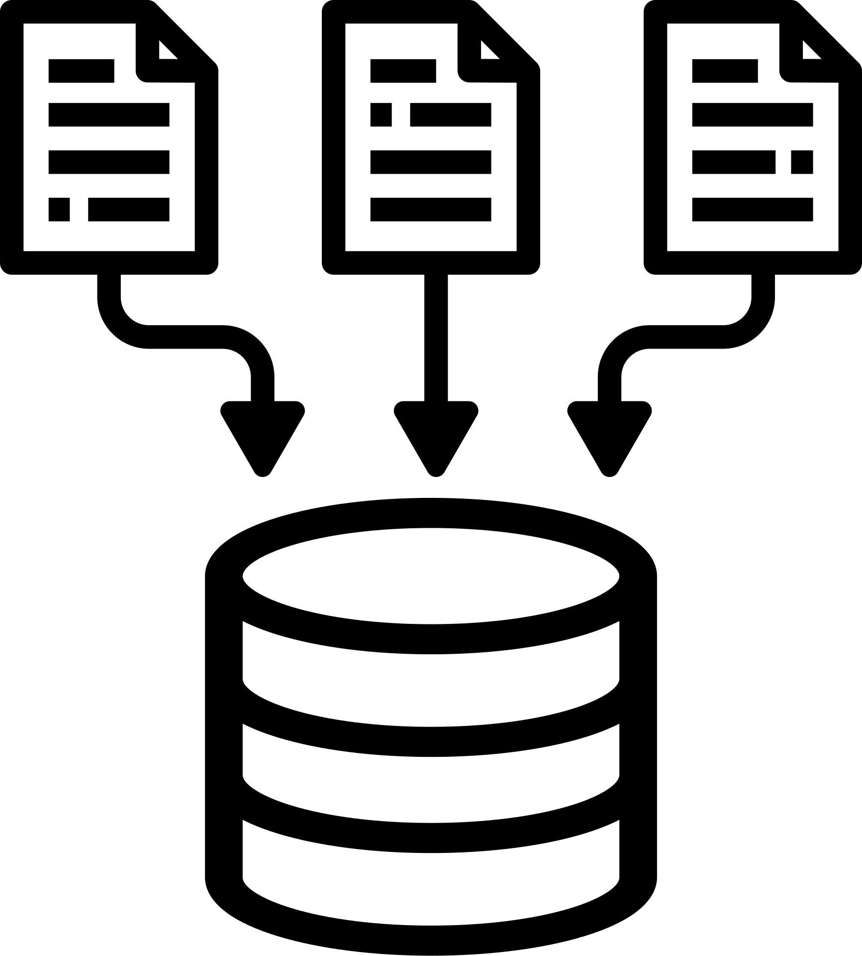



Diving into the mobile money payment ecosystem
03
Data Layer
Readiness in enabling consented, secure data sharing from users, products and services.
02
Payments Layer
Readiness in allowing anyone to pay anyone in the ecosystem interoperable, cheaply and quickly.
01
KYC Layer
Digital Readiness gives every consumer a unique ID as part of a centralised and secure system.

Slide 13
An example of a National Payments infrastructure
Consumers and small business spread across the country
Future Overlay Services
Shared bill pay, bulk pay, merchant pay services, for example
Non exclusive agents and aggregators
Consumers
Consumers
Consumers
Consumers
Consumers
Consumers
Consumers
Consumers
Consumers
Consumers
Consumers
Consumers
Consumers
Consumers
SME’s
Merchants
Billers & Enterprises
Government
Agents
Agent Aggregators
Consumers
DFSPs
Sponsored by DFSPs
Digital Financial Services Provider Bank
Aggregators, Processors, etc.
Digital Financial Services Provider Bank
e-Money Issuers
Banks
Third Parties, Processors, PSPs, etc.
E-Money Trust Accounts
Mobile Number Portability Service if available
Real-Time Payment System (RTPS)
Other Payments Networks
Optional; other networks run in parallel
Payment Address Lookup Service
Payment Transfer Clearing
National Identity Database
Automatic Settlement
Database and Fraud Utility
Financial Services Registry
Registry of all entities on system,: merchants, billers, agents, etc.
Scheme Operating Rules
Written by Central Bank; input by DFSPs; binds all DFSPs
DFSP Advisory Group
Advice on rules and development plans
Third Party Advisory Group
Processors, aggregators, billers, merchants - advice on use of system
Reserve Bank Settlement Accounts
Tanzania Instant Payment Systems

Slide 14
Regional Play

Slide 15
Regional Interoperability
To efficiently integrate into the regional switch, first establish a national switch that connects all in-country DFSPs.
Regional Switch
A regional level switch will connect to each country level national switch, the success of the regional program depends on the success of the national programs.
Regional Switch
Inclusive, National, Real-Time Payment Switch
The country’s national switch is implemented and connects all DFSPs (Banks and Non-bank financial service providers)
National Real Time Payment Switch
Non-DSFPs
MFIs
Stable National Payment System
All DFSPs (Bank and Non-Bank Financial services providers) are operating dependably at acceptable service levels
E-Money Issuers
Banks
Source: Building RTPS forum

Slide 16



Data Privacy and PII
Regulator at member state A
Regulator at member state B
Agreement of Terms
DFSP A
DFSP B
Payment Instruction
PII
Warranty
Warranty
PII requirements can be agreed upon ad hoc as part of the terms’ agreement.
A warranty that the PII will be provided on request is attached to the payment instructions.
The creditor institution and any intermediaries are responsible for securely storing the warranty.
If a regulator wants to see the PII, it asks the party that owns the PII (or, perhaps, the IPS to which the party belongs).
Credit: Michael Richard

Slide 17
Key Success Factors

Slide 18





Key Success Factors
E-KYC and Centralised Registries
Regulatory Collaboration between Central Banks and Telecommunications Regulators
Transparency in License Processing Timelines and Feedback
Oversight and Supervision Models
Training and Capacity Building Workshops

Slide 19





Key Success Factors
Regtech, enabling smarter and proactive oversight
Data Privacy, Data Sharing and Monitoring of Data Gaps
Cross-border transfers and interoperability
Issuance of Mobile Money, Fees and Mobile Money Business Models
Savings and Other Intermediary Products

Slide 20

Asante sana
Merci beaucoup
Muito Obrigado Thank you
Innocent Ephraim
Co-Founder - IDEA
WhatsApp: +255 754 710 450 Cell: +27 82 0411 442
Website: www.idea.co.tz
Email: innocent.ephraim@idea.co.tz
General: info@idea.co.tz

